Slide 1
I/O Systems Lesson 3 Kernel I/O Systems
David Liu
Fall 2021

Slide 2
Kernel I/O Subsystem
Scheduling
Some I/O request ordering via per-device queue
Some OSs try fairness
Some implement Quality Of Service (i.e. IPQOS)
Buffering - store data in memory while transferring between devices
To cope with device speed mismatch
To cope with device transfer size mismatch
To maintain “copy semantics”
Double buffering – two copies of the data
Kernel and user
Varying sizes
Full / being processed and not-full / being used
Copy-on-write can be used for efficiency in some cases

Slide 3
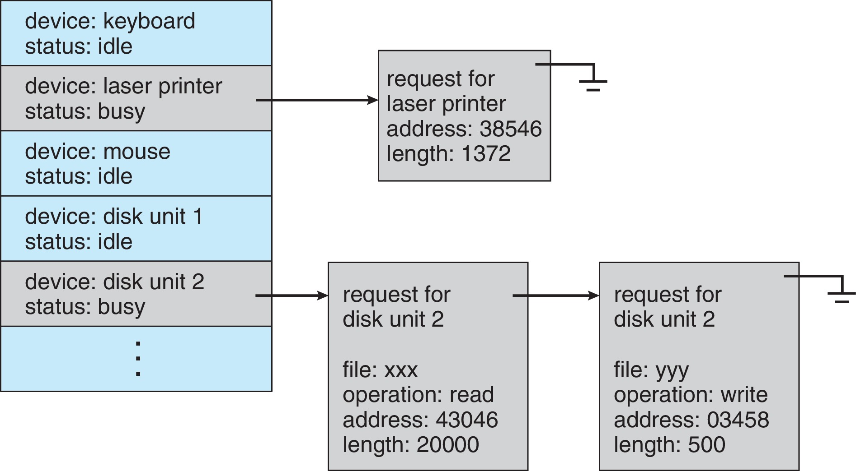
Device-status Table

Slide 4
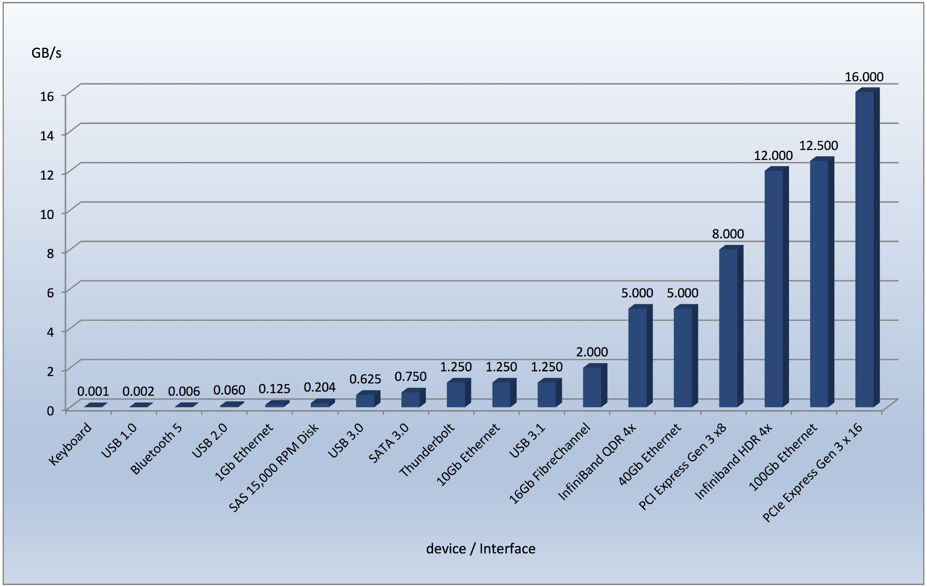
Common PC and Data-center I/O devices and Interface Speeds

Slide 5
Kernel I/O Subsystem
Caching - faster device holding copy of data
Always just a copy
Key to performance
Sometimes combined with buffering
Spooling - hold output for a device
If device can serve only one request at a time
i.e., Printing
Device reservation - provides exclusive access to a device
System calls for allocation and de-allocation
Watch out for deadlock

Slide 6
Error Handling
OS can recover from disk read, device unavailable, transient write failures
Retry a read or write, for example
Some systems more advanced – Solaris FMA, AIX
Track error frequencies, stop using device with increasing frequency of retry-able errors
Most return an error number or code when I/O request fails
System error logs hold problem reports

Slide 7
I/O Protection
User process may accidentally or purposefully attempt to disrupt normal operation via illegal I/O instructions
All I/O instructions defined to be privileged
I/O must be performed via system calls
Memory-mapped and I/O port memory locations must be protected too

Slide 8
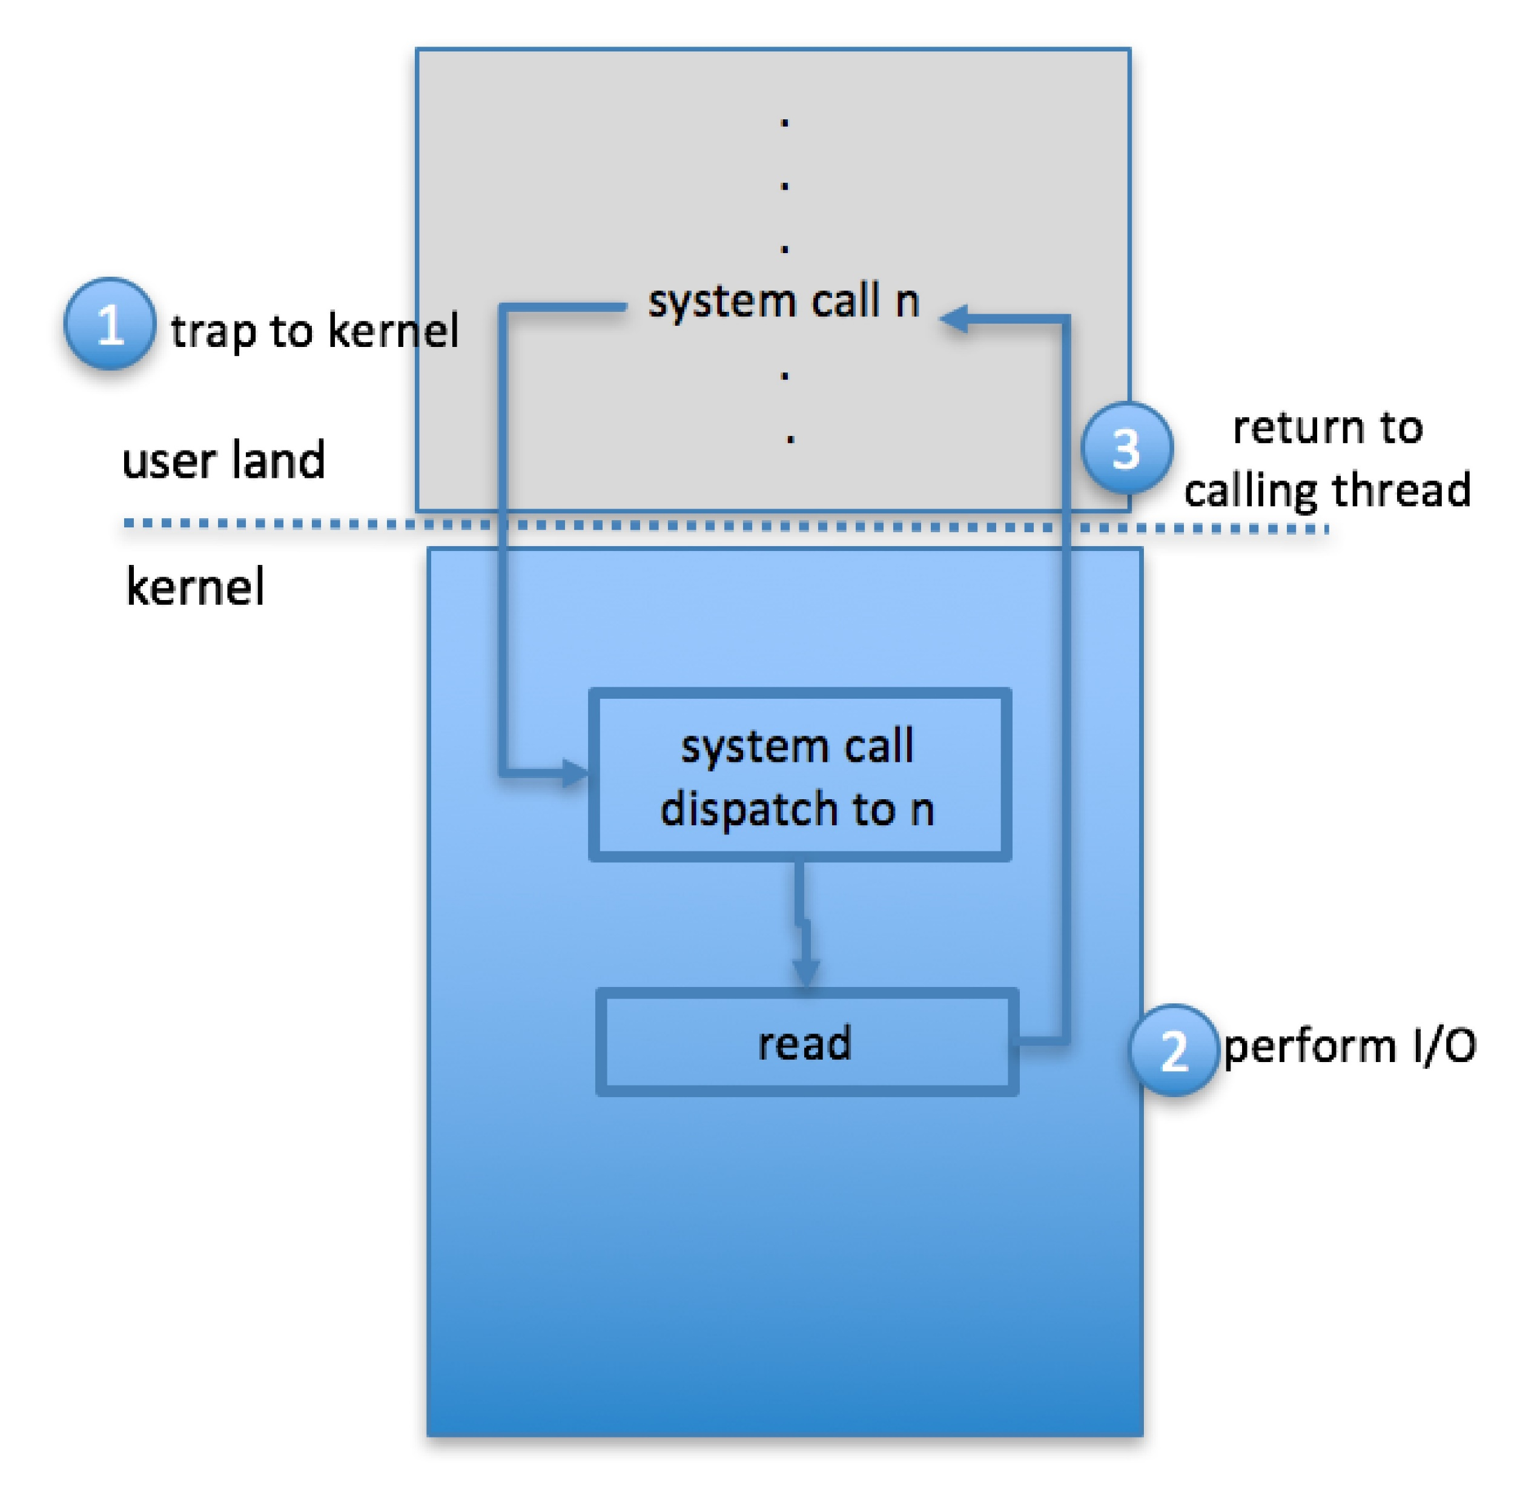
Use of a System Call to Perform I/O

Slide 9
Kernel Data Structures
Kernel keeps state info for I/O components, including open file tables, network connections, character device state
Many, many complex data structures to track buffers, memory allocation, “dirty” blocks
Some use object-oriented methods and message passing to implement I/O
Windows uses message passing
Message with I/O information passed from user mode into kernel
Message modified as it flows through to device driver and back to process
Pros / cons?

Slide 10
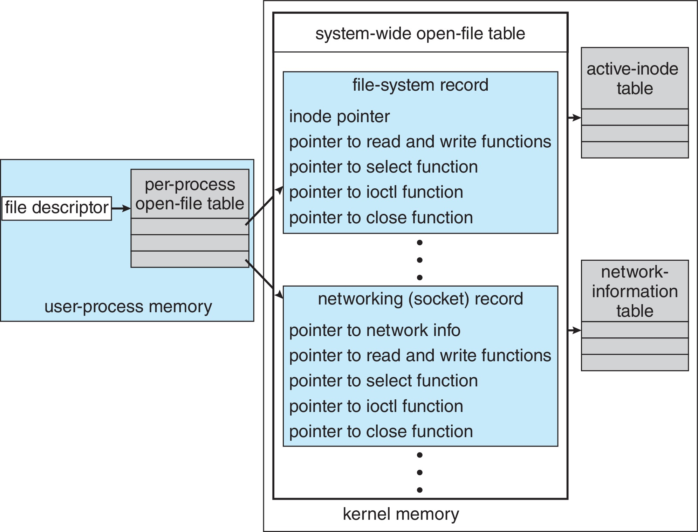
UNIX I/O Kernel Structure

Slide 11
Power Management
Not strictly domain of I/O, but much is I/O related
Computers and devices use electricity, generate heat, frequently require cooling
OSes can help manage and improve use
Cloud computing environments move virtual machines between servers
Can end up evacuating whole systems and shutting them down
Mobile computing has power management as first class OS aspect

Slide 12
Power Management (Cont.)
For example, Android implements
Component-level power management
Understands relationship between components
Build device tree representing physical device topology
System bus -> I/O subsystem -> {flash, USB storage}
Device driver tracks state of device, whether in use
Unused component – turn it off
All devices in tree branch unused – turn off branch
Wake locks – like other locks but prevent sleep of device when lock is held
Power collapse – put a device into very deep sleep
Marginal power use
Only awake enough to respond to external stimuli (button press, incoming call)

Slide 13
Power Management (Cont.)
Modern systems use advanced configuration and power interface (ACPI) firmware providing code that runs as routines called by kernel for device discovery, management, error and power management

Slide 14
Kernel I/O Subsystem Summary
In summary, the I/O subsystem coordinates an extensive collection of services that are available to applications and to other parts of the kernel
Management of the name space for files and devices
Access control to files and devices
Operation control (for example, a modem cannot seek())
File-system space allocation
Device allocation
Buffering, caching, and spooling
I/O scheduling
Device-status monitoring, error handling, and failure recovery
Device-driver configuration and initialization
Power management of I/O devices
The upper levels of the I/O subsystem access devices via the uniform interface provided by the device drivers

